Slide 1
“Learning how to learn course”

Slide 2
Print screens belong to the course Learning how to learn” lead by Barbara Oakley and available in Coursera

Slide 3
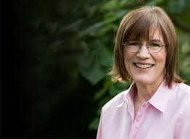

Special Thanks to:
Barbara Oakley Professor of Engineering at Oakland University and McMaster University
Coursera

Slide 4

Learning Meaning
Acquisition of knowledge or skills through study, experience, or being taught.
We prize our abilities to do anything.
But it takes years of practice to acquire and prefection these skills.

Slide 5
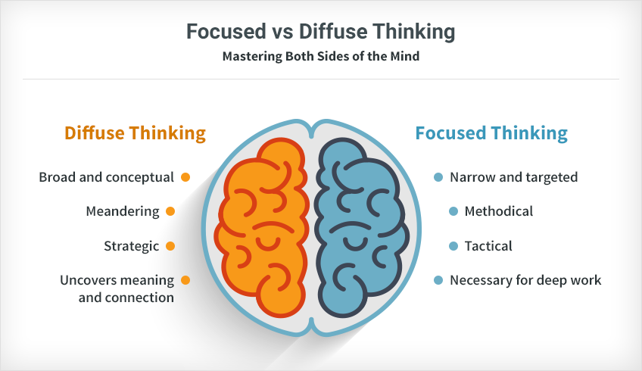
Source: https://www.7pace.com/blog/focused-vs-diffuse-thinking

Slide 6


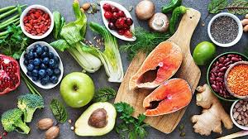
Good Habits to your Brain

Slide 7
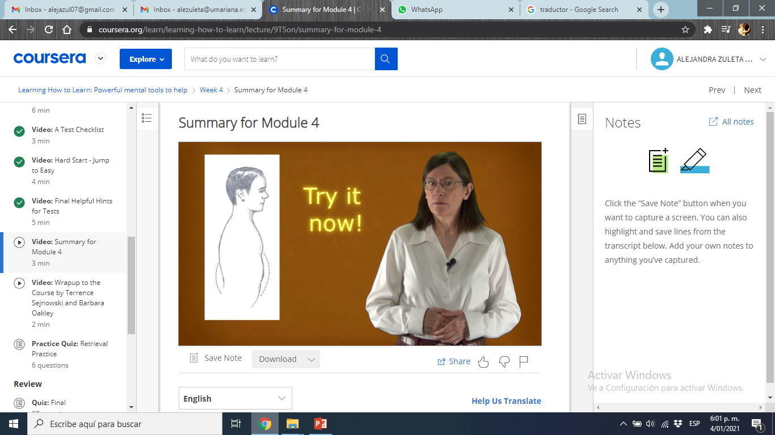
Focus on your breath
Place your screenshot here

Slide 8
Practices makes permanent
This means it's important to practice with ideas and concepts.
Practices is necessary in the greater scheme of all the different careers and disciplines.
Some areas like math's has abstract nature of the ideas, that make their more challenging.

Slide 9
Acting and doing
Chess masters, emergency room physicians, fighter pilots, and many other experts often have to make complex decisions rapidly.
They shut down their conscious system and instead rely on their well trained intuition, drawing on their deeply ingrained repertoire of chunks.
At some point self-consciously understanding why you do what you do.

Slide 10
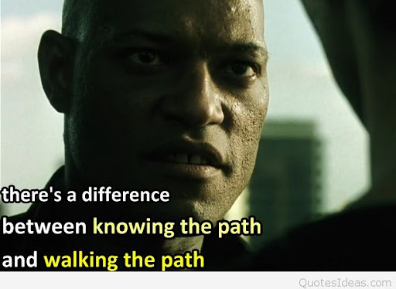
Acting and doing
Are genius exceptionally gifted? Not necessarily.
Sure, intelligence matters.
Being smarter often equates to having a larger working memory.
Your hot rod of a memory may be able to hold nine things in mind instead of four.
Challenge your self!!

Slide 11
Acting and doing
Use your motivation and passion.
Do test and evaluations constantly.
Review your work, do it as slow as possible.
Begin with difficul, pass to something easier. Switch from focused to difuse mode.
Select our Teammates: test and explanations.

Slide 12
Memory importance
You need time (rest or change of activity) for the synoptic connections to form and strength.
Extending your practice over several days does make a difference then.
But, Beware of overload fatigue.
Funny memories.

Slide 13
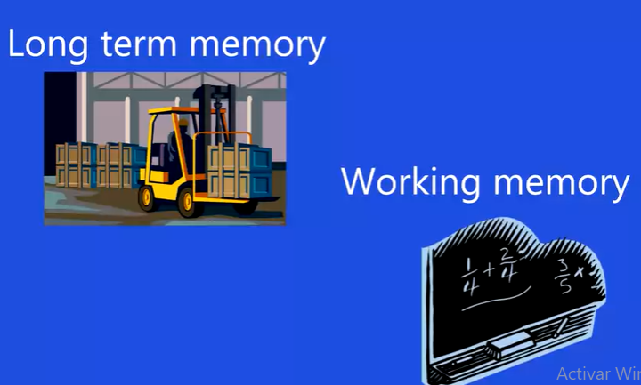
SOME TIPS:
Associate numbers to important dates, years, amounts.
Visualize the knoweldge, feel it, create smells and flavors.
Use the Palace Techniques for what you learn.
Place your screenshot here

Slide 14
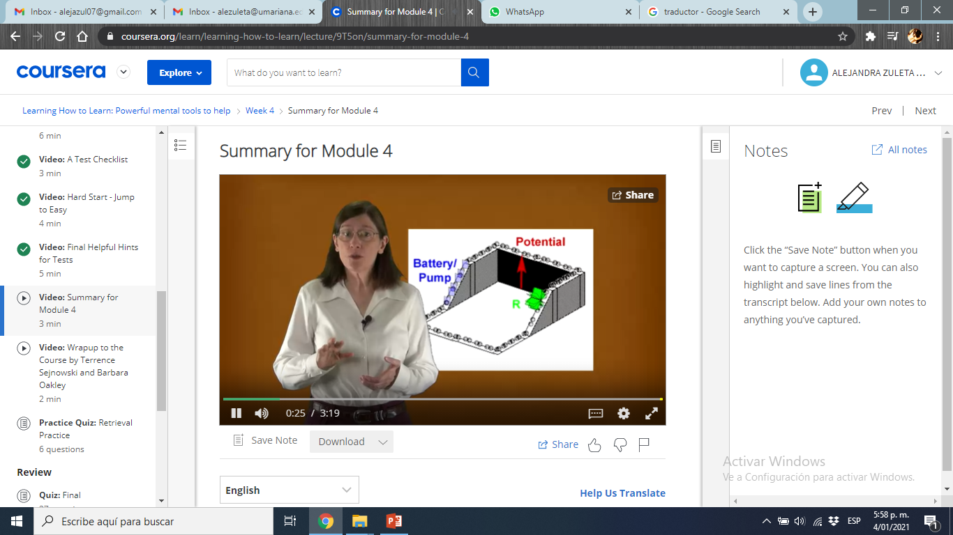
Enter to the problem or concept by your self, visualice it!!
Place your screenshot here

Slide 15
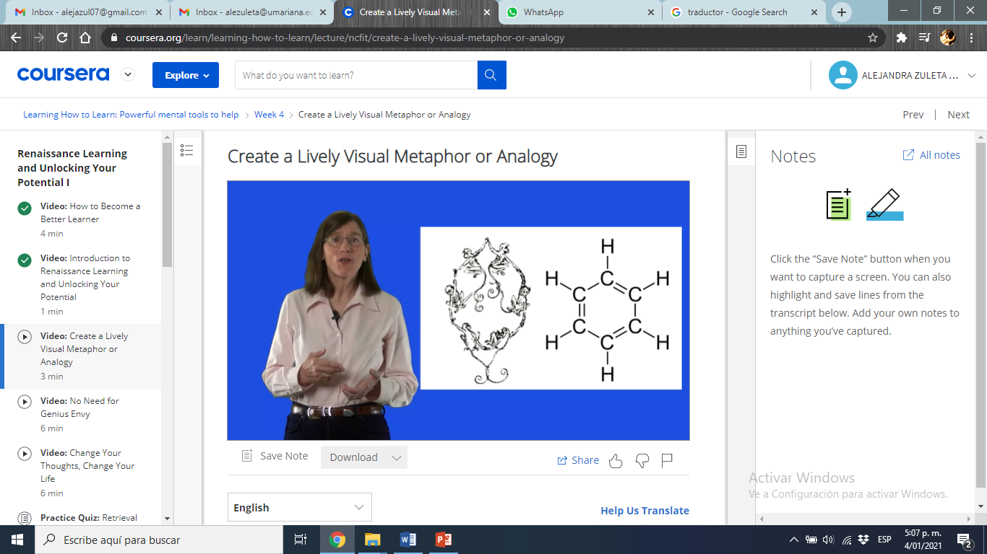
Use analagioes and methapors to understand
Place your screenshot here

Slide 16
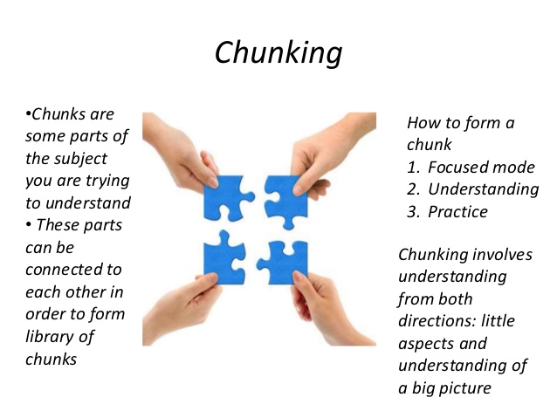
Source: https://www.slideshare.net/IliaIlin1/what-ive-learned-from-the-course-learning-how-to-learn
Author: Ilia Ilin

Slide 17

UNDERSTANDING

Slide 18
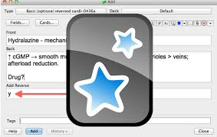
Illusions of learning
This improved learning comes whether students take a formal test, or just informally test themselves.
The retrieval process itself enhances deep learning, and helps us to begin forming chunks.
Test your self!! Recommended App: Anki

